Slide 1
Classes
Notes:
https://www.w3schools.com/python/python_classes.asp

Slide 2
Lesson Objectives
Explain what a class is, how to create one, and what the purpose of them is
Introduce practical uses of a class (accessing attributes, etc)
Explore the concept of inheritance and practice using child classes
How to import classes into another piece of code

Slide 3
Class - What is it?
Python is an object oriented programming language. In object-oriented programming you write classes that represent real-world things and situations, and you create objects based on these classes.
A Class is like an object constructor, or a "blueprint" for creating objects.

Slide 4
Creating and Using a Class
You can model almost anything using a class. To start, you use the keyword ‘class’
You then need to think about what you are modelling…

Slide 5
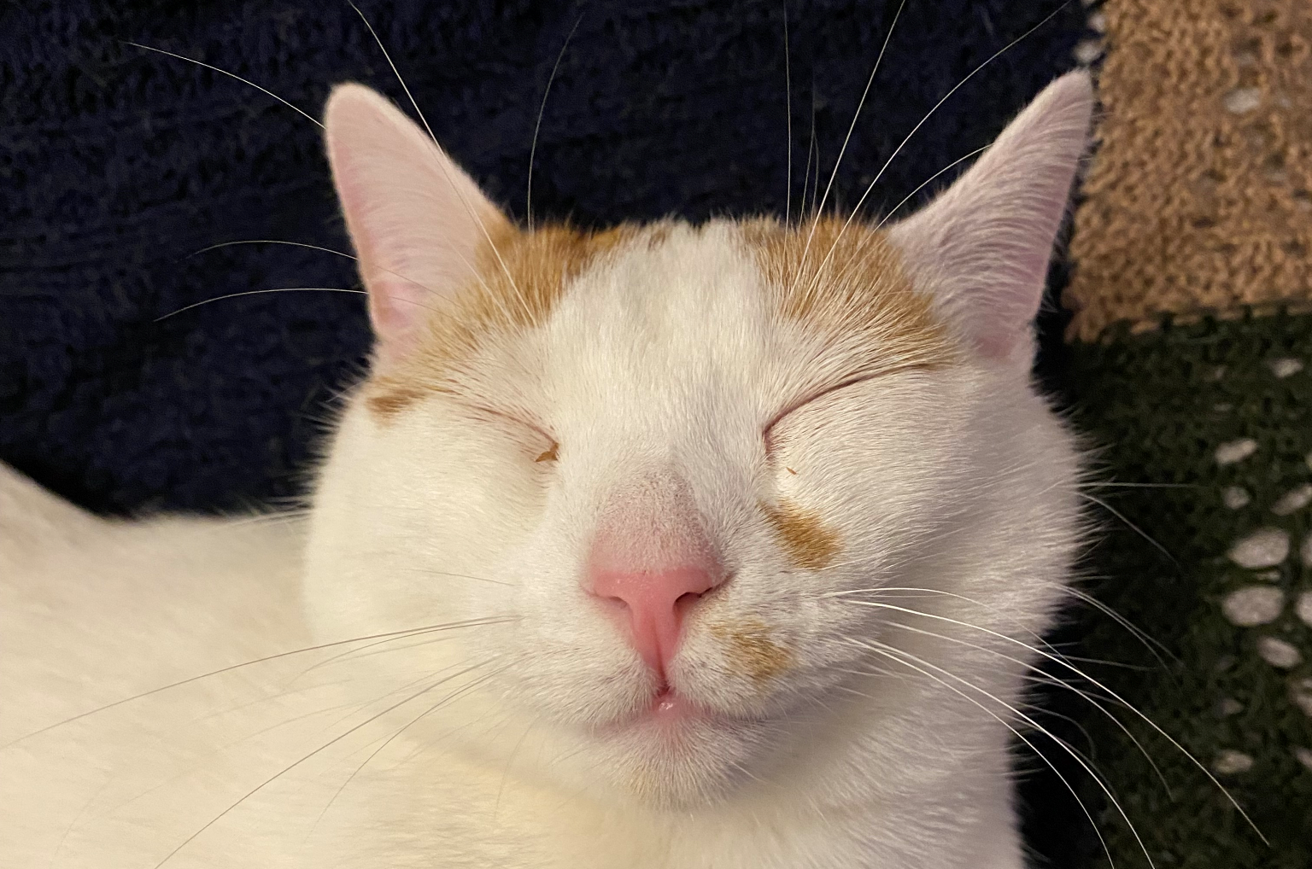
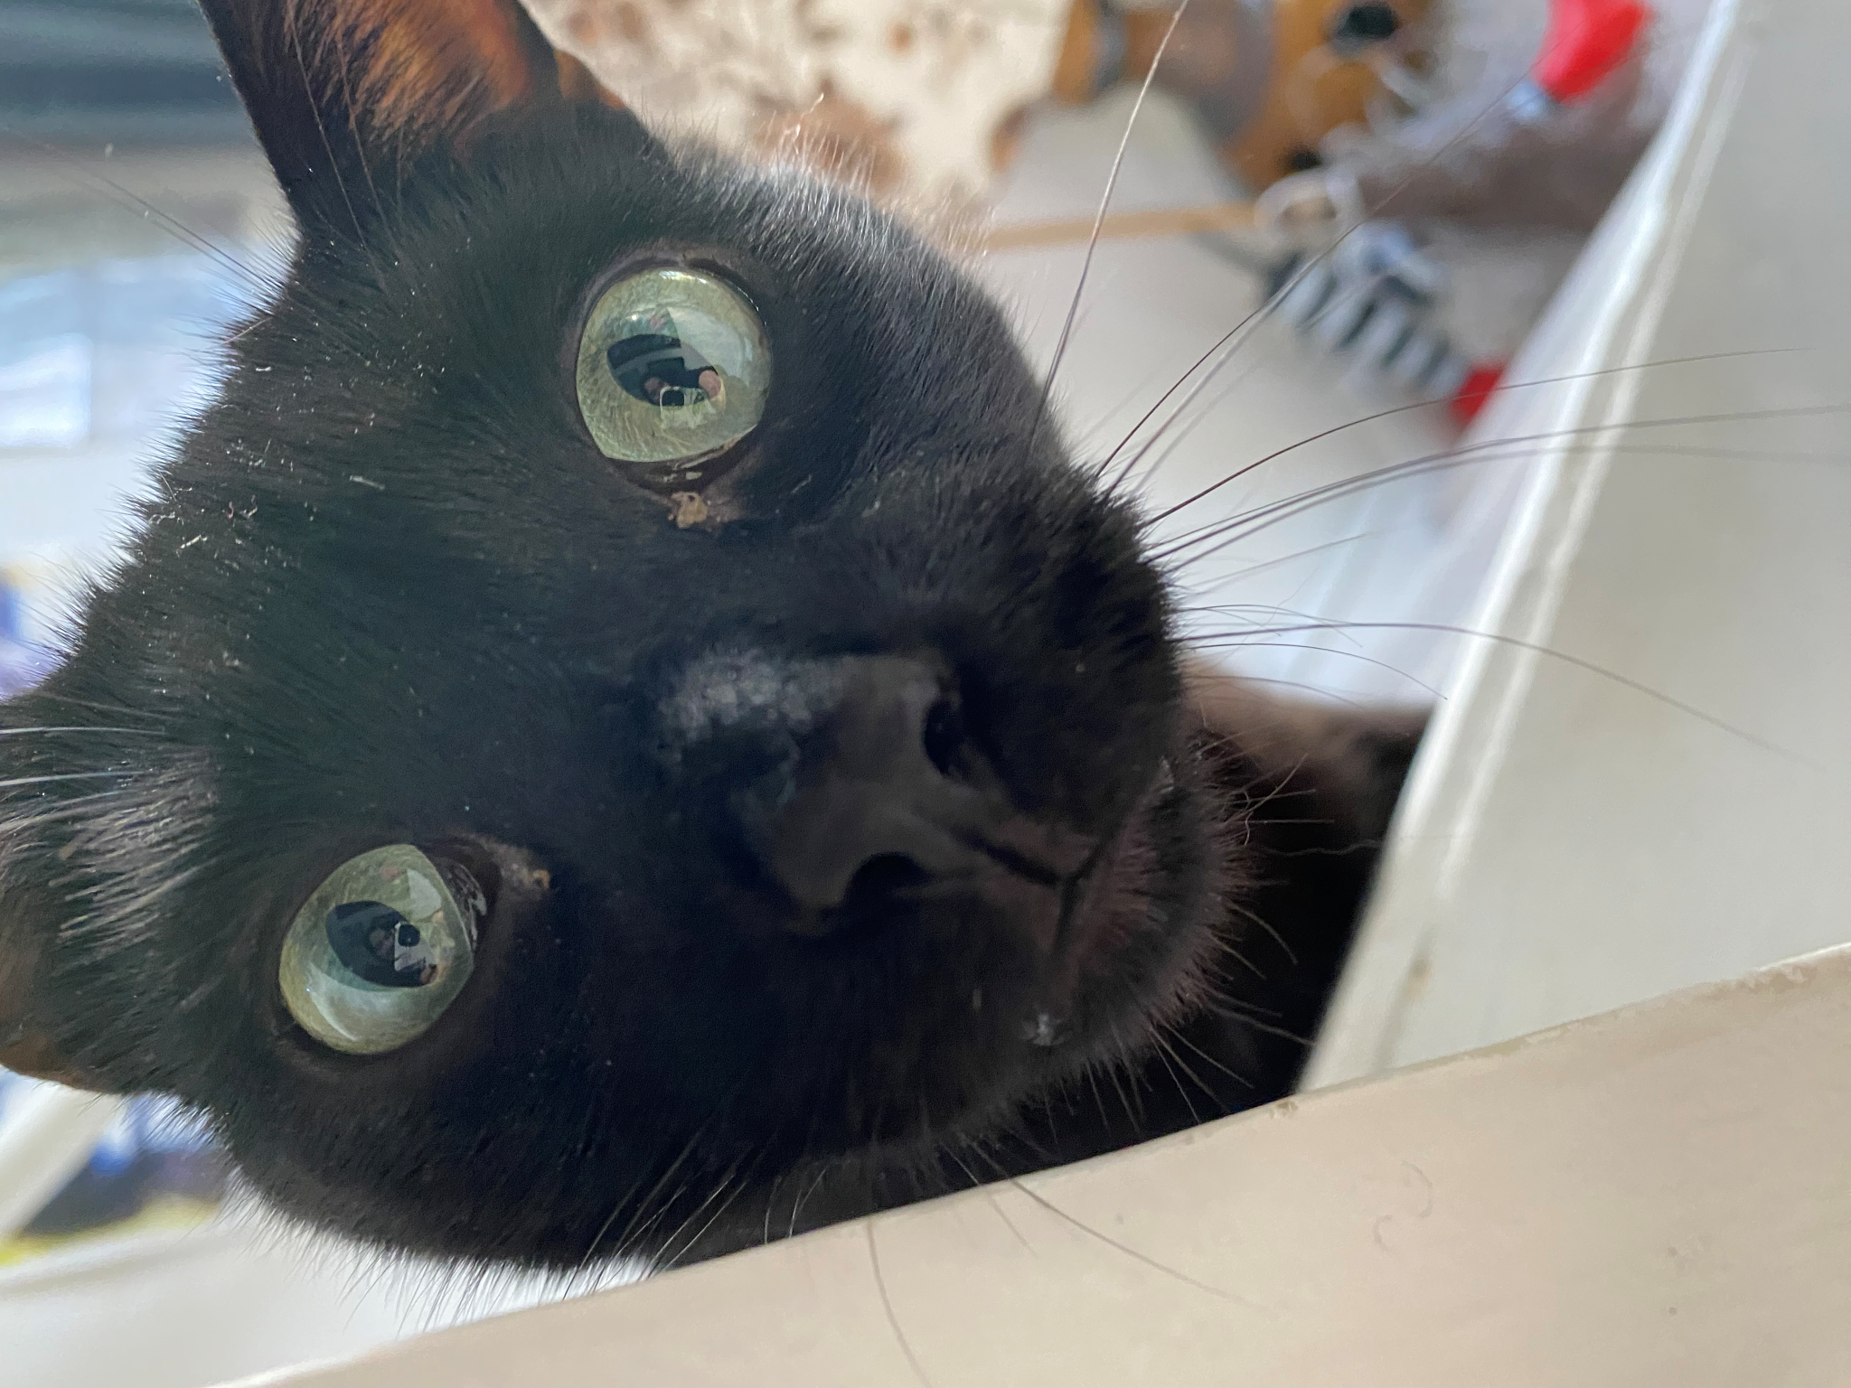
Bring in the CATS
Think about what a cat is…….. Cats have a name, fur, age.
They also do things like sleep and climb on things.
We will create a class that will store the name of a cat, the age of the cat and give the cat the ability to climb and sleep.

Slide 6
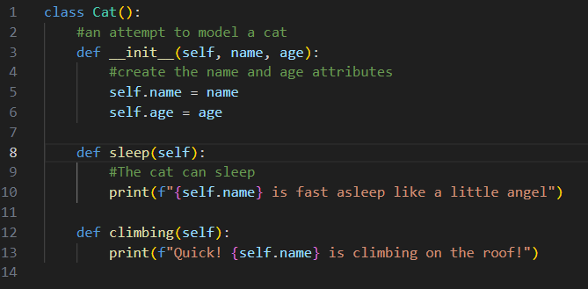
Notes:
class Cat():
#an attempt to model a cat
def __init__(self, name, age):
#create the name and age attributes
self.name = name
self.age = age
def sleep(self):
#The cat can sleep
print(f"{self.name} is fast asleep like a little angel")
def climbing(self):
print(f"Quick! {self.name} is climbing on the roof!")

Slide 7

Let’s Break it Down

Slide 8
Methods
A function that is part of a class is called a method. This is the exact same thing as functions that we learned previously! Just named something different when within classes.

Slide 9
Notes:
class Cat():
#an attempt to model a cat
def __init__(self, name, age):
#create the name and age attributes
self.name = name
self.age = age
def sleep(self):
#The cat can sleep
print(f"{self.name} is fast asleep like a little angel")
def climbing(self):
print(f"Quick! {self.name} is climbing on the roof!")
# Creating an instance of the Cat class
my_cat = Cat(name="Weasley", age=1)
# Accessing attributes of the cat
print(f"My cat's name is {my_cat.name} and it's {my_cat.age} years old.")
In this code, we have a class called Cat. The class has three methods: __init__, sleep, and climbing.
Here, we create an instance of the Cat class named my_cat and provide it with a name ("Weasley") and an age (1) during initialization.
We can access the attributes of our cat instance using my_cat.name and my_cat.age. This helps us learn more about our cat's details.
Our cat has a sleep method. When we call this method, it prints a message indicating that the cat is fast asleep.
# Calling the sleep method
my_cat.sleep()
The cat can also climb! When we call the climbing method, it notifies us that our cat is climbing on the roof.
# Calling the climbing method
my_cat.climbing()
And there you have it! We've created a simple Python class Cat that models a cat's behavior. It has attributes for name and age, and methods to simulate actions like sleeping and climbing.

Slide 10
__init__() Method
All classes have a function called __init__(), which is always executed when the class is being initiated. Use the __init__() function to assign values to object properties, or other operations that are necessary to do when the object is being created

Slide 11
Notes:
class Cat():
#an attempt to model a cat
def __init__(self, name, age):
#create the name and age attributes
self.name = name
self.age = age
def sleep(self):
#The cat can sleep
print(f"{self.name} is fast asleep like a little angel")
def climbing(self):
print(f"Quick! {self.name} is climbing on the roof!")
# Creating an instance of the Cat class
my_cat = Cat(name="Weasley", age=1)
# Accessing attributes of the cat
print(f"My cat's name is {my_cat.name} and it's {my_cat.age} years old.")

Slide 12
The self parameter
The self parameter is a reference to the instance itself; giving the individual instance access to the attributes and methods from within the class.

Slide 13
Notes:
class Cat():
#an attempt to model a cat
def __init__(self, name, age):
#create the name and age attributes
self.name = name
self.age = age
def sleep(self):
#The cat can sleep
print(f"{self.name} is fast asleep like a little angel")
def climbing(self):
print(f"Quick! {self.name} is climbing on the roof!")
# Creating an instance of the Cat class
my_cat = Cat(name="Weasley", age=1)
# Accessing attributes of the cat
print(f"My cat's name is {my_cat.name} and it's {my_cat.age} years old.")
In this code, we have a class called Cat. The class has three methods: __init__, sleep, and climbing.
Here, we create an instance of the Cat class named my_cat and provide it with a name ("Weasley") and an age (1) during initialization.
We can access the attributes of our cat instance using my_cat.name and my_cat.age. This helps us learn more about our cat's details.
Our cat has a sleep method. When we call this method, it prints a message indicating that the cat is fast asleep.
# Calling the sleep method
my_cat.sleep()
The cat can also climb! When we call the climbing method, it notifies us that our cat is climbing on the roof.
# Calling the climbing method
my_cat.climbing()
And there you have it! We've created a simple Python class Cat that models a cat's behavior. It has attributes for name and age, and methods to simulate actions like sleeping and climbing.

Slide 14
So, think of a class as a set of instructions to make an instance… They are the blueprints in order to make individual instances related to something… Or in our case, cats. Let’s make one for a cat…

Slide 15
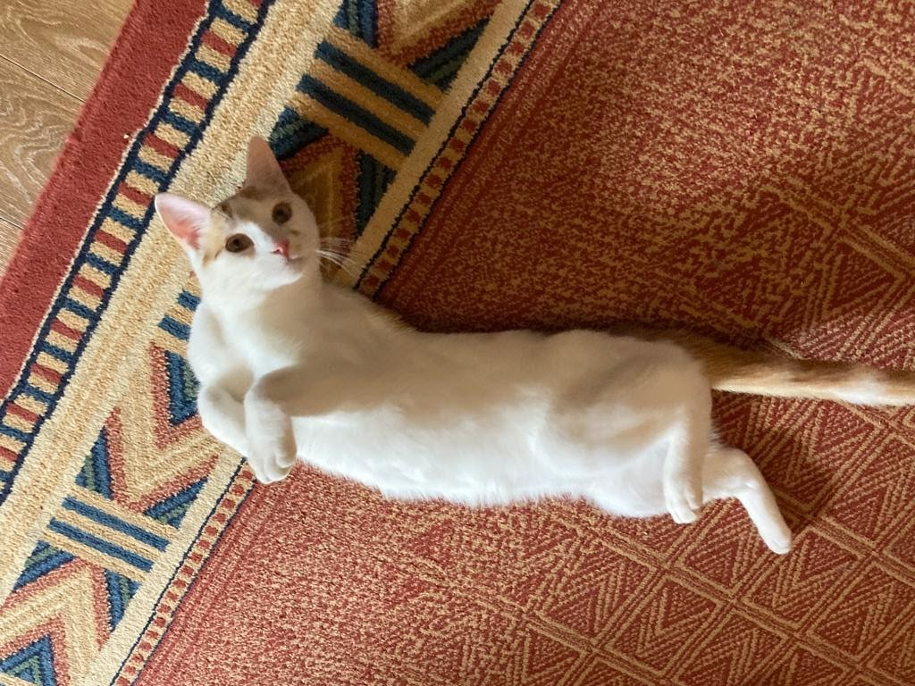

Slide 16
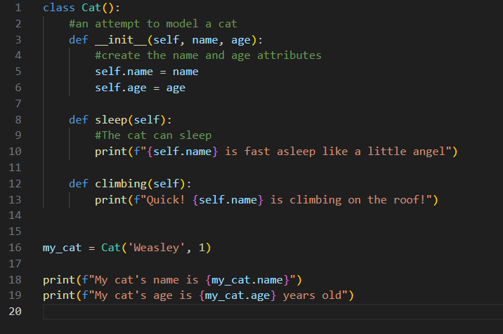

Slide 17
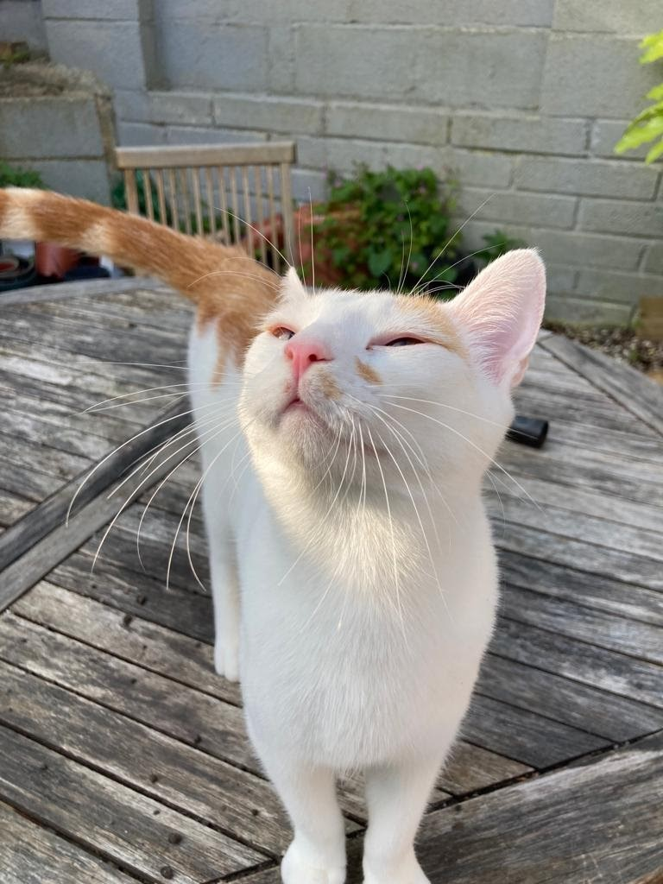
Making an Instance of Weasley
What is happening in the background?
The __init__() method creates an instance representing Weasley and sets the name and age attributes using the values that we provide later in the code. Python then returns and instance that represents Weasley. We assign the instance to ‘my_cat’.
Self represents the instance of the class. By using the “self” we can access the attributes and methods of the class in Python. It binds the attributes with the given arguments.
Notes:
class Cat():
#an attempt to model a cat
def __init__(self, name, age):
#create the name and age attributes
self.name = name
self.age = age
def sleep(self):
#The cat can sleep
print(f"{self.name} is fast asleep like a little angel")
def climbing(self):
print(f"Quick! {self.name} is climbing on the roof!")
my_cat = Cat('Weasley', 1)
print(f"My cat's name is {my_cat.name}")
print(f"My cat's age is {my_cat.age} years old")
https://www.geeksforgeeks.org/self-in-python-class/

Slide 18
Class: Cat
Name, age, sleeps, climbs
Object: Weasley
Instance of Class:Cat
Object: Noche
Instance of Class:Cat

Slide 19
Class: House
Describes what a house is
Object: my house
Instance of Class:House
Object: your house
Instance of Class:House
Notes:
Our class is just an idea of what something is. We are describing what things are to Python.

Slide 20
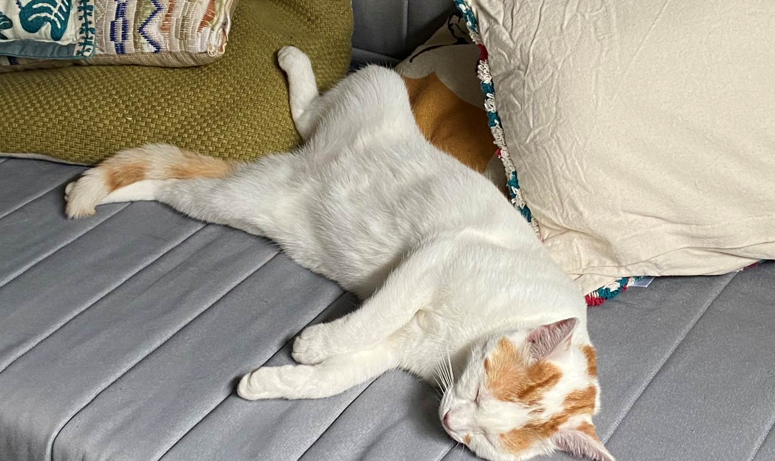
Calling Methods
Remember DOT NOTATION. Let’s look at what happens when Weasley sleeps or climbs…
To call a method, give the name of the instance and method you want to call, separated by a dot.
Notes:
class Cat():
#an attempt to model a cat
def __init__(self, name, age):
#create the name and age attributes
self.name = name
self.age = age
def sleep(self):
#The cat can sleep
print(f"{self.name} is fast asleep like a little angel")
def climbing(self):
print(f"Quick! {self.name} is climbing on the roof!")
my_cat = Cat('Weasley', 1)
print(f"My cat's name is {my_cat.name}")
print(f"My cat's age is {my_cat.age} years old")
my_cat.sleep()
my_cat.climbing()

Slide 21
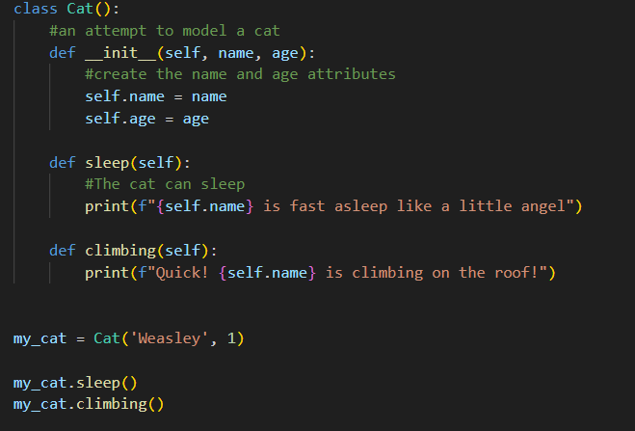
Notes:
class Cat():
#an attempt to model a cat
def __init__(self, name, age):
#create the name and age attributes
self.name = name
self.age = age
def sleep(self):
#The cat can sleep
print(f"{self.name} is fast asleep like a little angel")
def climbing(self):
print(f"Quick! {self.name} is climbing on the roof!")
my_cat = Cat('Weasley', 1)
my_cat.sleep()
my_cat.climbing()

Slide 22
Accessing Attributes
We use dot notation to access specific attributes from a class.

Slide 24
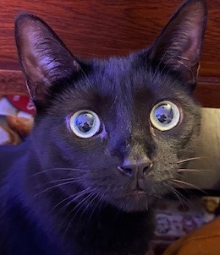
But… WHAT ABOUT NOCHE?!

Slide 25
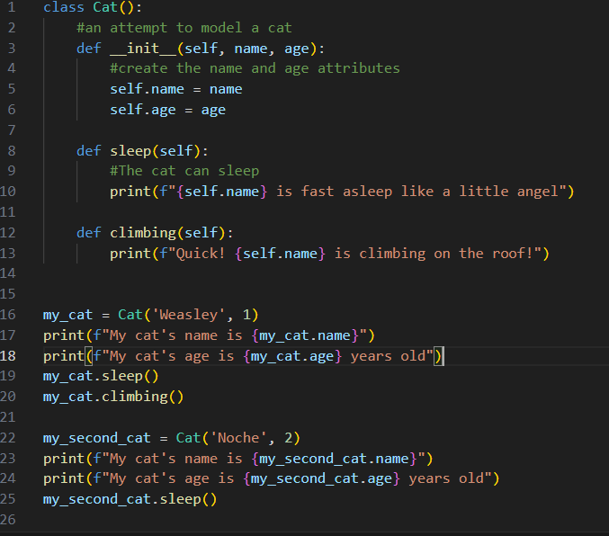
Creating Multiple Instances
You can create as many instances from a class as you need!! Just as long as you give each instance (in this case Weasley and Noche) a unique variable name.
Notes:
class Cat():
#an attempt to model a cat
def __init__(self, name, age):
#create the name and age attributes
self.name = name
self.age = age
def sleep(self):
#The cat can sleep
print(f"{self.name} is fast asleep like a little angel")
def climbing(self):
print(f"Quick! {self.name} is climbing on the roof!")
my_cat = Cat('Weasley', 1)
print(f"My cat's name is {my_cat.name}")
print(f"My cat's age is {my_cat.age} years old")
my_cat.sleep()
my_cat.climbing()
my_second_cat = Cat('Noche', 2)
print(f"My cat's name is {my_second_cat.name}")
print(f"My cat's age is {my_second_cat.age} years old")
my_second_cat.sleep()

Slide 26
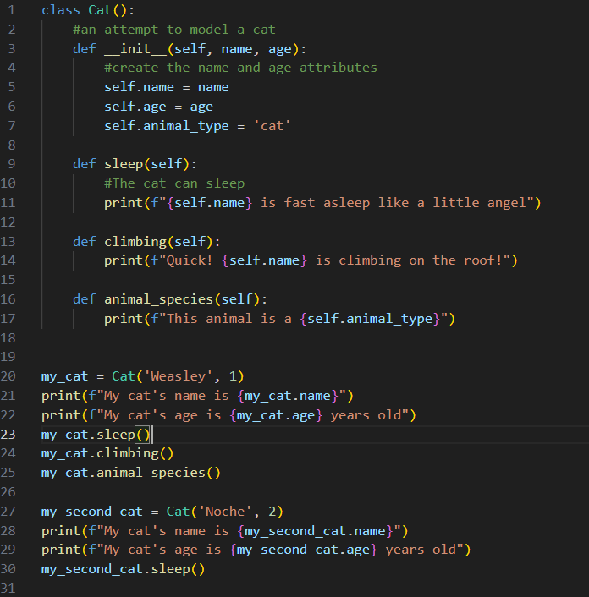
Default Values for an Attribute
I added a new attribute called animal_type on line 7 and set a default value.
I then created a new method called animal_species to use on line 25.
Notes:
class Cat():
#an attempt to model a cat
def __init__(self, name, age):
#create the name and age attributes
self.name = name
self.age = age
self.animal_type = 'cat'
def sleep(self):
#The cat can sleep
print(f"{self.name} is fast asleep like a little angel")
def climbing(self):
print(f"Quick! {self.name} is climbing on the roof!")
def animal_species(self):
print(f"This animal is a {self.animal_type}")
my_cat = Cat('Weasley', 1)
print(f"My cat's name is {my_cat.name}")
print(f"My cat's age is {my_cat.age} years old")
my_cat.sleep()
my_cat.climbing()
my_cat.animal_species()
my_second_cat = Cat('Noche', 2)
print(f"My cat's name is {my_second_cat.name}")
print(f"My cat's age is {my_second_cat.age} years old")
my_second_cat.sleep()

Slide 27
Modifying Attribute Values
A couple ways to do this:
Modify an attribute’s value directly
Modify an attribute’s value through a method

Slide 28
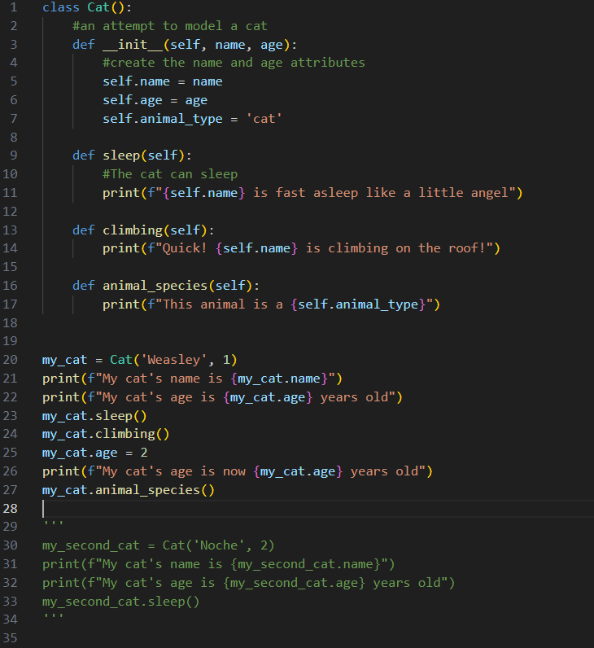
Modify an attribute’s value directly
Line 25 I changed the attribute to ‘2’ instead of ‘1’
Notes:
class Cat():
#an attempt to model a cat
def __init__(self, name, age):
#create the name and age attributes
self.name = name
self.age = age
self.animal_type = 'cat'
def sleep(self):
#The cat can sleep
print(f"{self.name} is fast asleep like a little angel")
def climbing(self):
print(f"Quick! {self.name} is climbing on the roof!")
def animal_species(self):
print(f"This animal is a {self.animal_type}")
my_cat = Cat('Weasley', 1)
print(f"My cat's name is {my_cat.name}")
print(f"My cat's age is {my_cat.age} years old")
my_cat.sleep()
my_cat.climbing()
my_cat.age = 2
print(f"My cat's age is now {my_cat.age} years old")
my_cat.animal_species()
'''
my_second_cat = Cat('Noche', 2)
print(f"My cat's name is {my_second_cat.name}")
print(f"My cat's age is {my_second_cat.age} years old")
my_second_cat.sleep()
'''

Slide 29
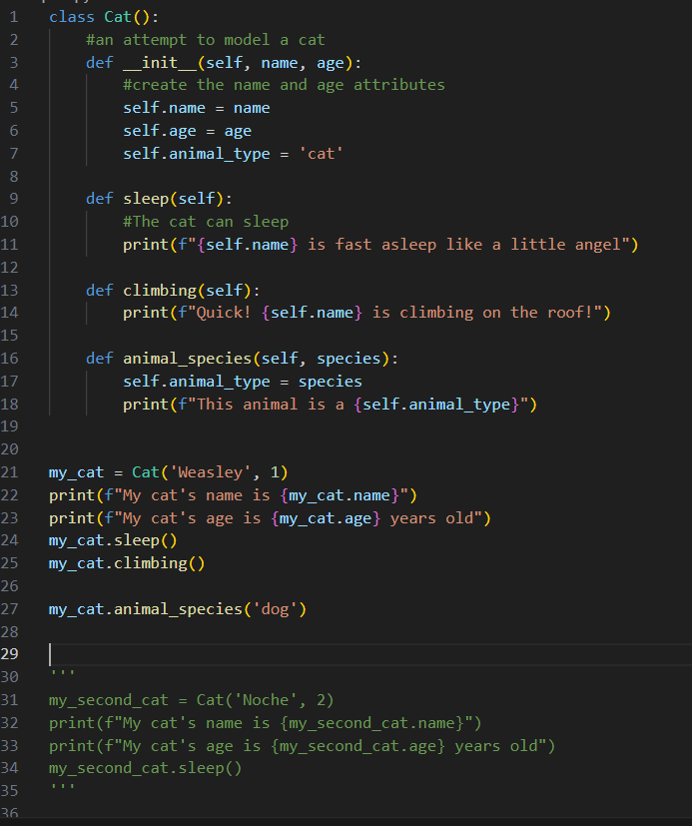
Modify an attribute’s value through a method
Notes:
class Cat():
#an attempt to model a cat
def __init__(self, name, age):
#create the name and age attributes
self.name = name
self.age = age
self.animal_type = 'cat'
def sleep(self):
#The cat can sleep
print(f"{self.name} is fast asleep like a little angel")
def climbing(self):
print(f"Quick! {self.name} is climbing on the roof!")
def animal_species(self, species):
self.animal_type = species
print(f"This animal is a {self.animal_type}")
my_cat = Cat('Weasley', 1)
print(f"My cat's name is {my_cat.name}")
print(f"My cat's age is {my_cat.age} years old")
my_cat.sleep()
my_cat.climbing()
my_cat.animal_species('dog')
'''
my_second_cat = Cat('Noche', 2)
print(f"My cat's name is {my_second_cat.name}")
print(f"My cat's age is {my_second_cat.age} years old")
my_second_cat.sleep()
'''

Slide 30
Inheritance
You do not always need to start from scratch when writing a class. If the class you’re writing is a specialized version of another class you wrote, you can use inheritance. When one class inherits from another, it automatically takes on all the attributes and methods of the first class. The original class is called the parent class, and the new class is the child class. The child class inherits every attribute and method from its parent class but is also free to define new attributes and methods of its own.

Slide 31
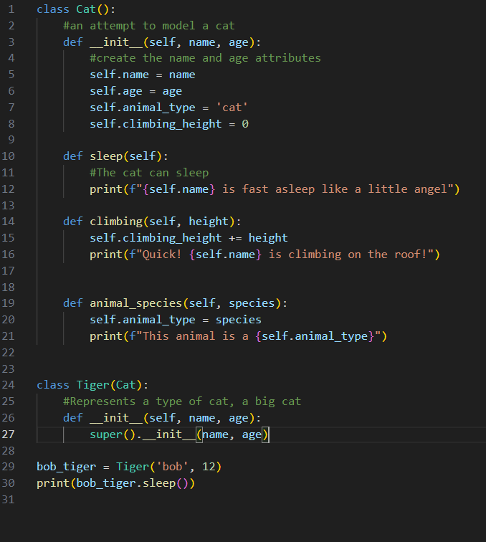
child_class(parent_class)
super() function is a special function that helps Python make connections between a parent and a child class.
The __init__ method takes in information required to make a Cat instance
Notes:
class Cat():
#an attempt to model a cat
def __init__(self, name, age):
#create the name and age attributes
self.name = name
self.age = age
self.animal_type = 'cat'
self.climbing_height = 0
def sleep(self):
#The cat can sleep
print(f"{self.name} is fast asleep like a little angel")
def climbing(self, height):
self.climbing_height += height
print(f"Quick! {self.name} is climbing on the roof!")
def animal_species(self, species):
self.animal_type = species
print(f"This animal is a {self.animal_type}")
class Tiger(Cat):
#Represents a type of cat, a big cat
def __init__(self, name, age):
super().__init__(name, age)
bob_tiger = Tiger('bob', 12)
print(bob_tiger.sleep())

Slide 32
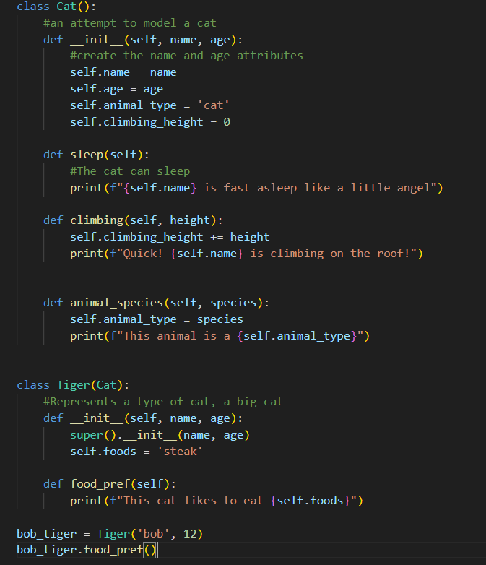
Defining Attributes and Methods for a Child Class
Notes:
class Cat():
#an attempt to model a cat
def __init__(self, name, age):
#create the name and age attributes
self.name = name
self.age = age
self.animal_type = 'cat'
self.climbing_height = 0
def sleep(self):
#The cat can sleep
print(f"{self.name} is fast asleep like a little angel")
def climbing(self, height):
self.climbing_height += height
print(f"Quick! {self.name} is climbing on the roof!")
def animal_species(self, species):
self.animal_type = species
print(f"This animal is a {self.animal_type}")
class Tiger(Cat):
#Represents a type of cat, a big cat
def __init__(self, name, age):
super().__init__(name, age)
self.foods = 'steak'
def food_pref(self):
print(f"This cat likes to eat {self.foods}")
bob_tiger = Tiger('bob', 12)
bob_tiger.food_pref()

Slide 33
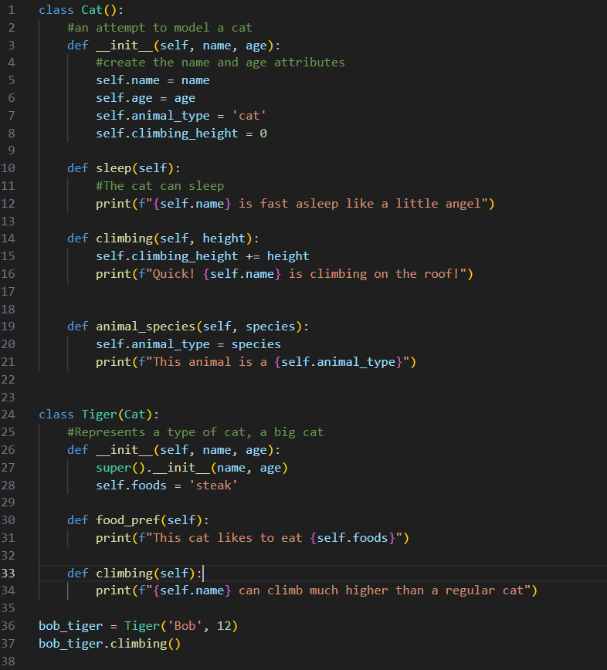
Overriding Methods from the Parent Class
You can override any method from the parent class that does not fit what you’re trying to model with the child class. To do this, you define a method in the child class with the same name as the method you want to override in the parent class. Python will disregard the parent class method and only pay attention to the method you define in the child class.
Notes:
class Cat():
#an attempt to model a cat
def __init__(self, name, age):
#create the name and age attributes
self.name = name
self.age = age
self.animal_type = 'cat'
self.climbing_height = 0
def sleep(self):
#The cat can sleep
print(f"{self.name} is fast asleep like a little angel")
def climbing(self, height):
self.climbing_height += height
print(f"Quick! {self.name} is climbing on the roof!")
def animal_species(self, species):
self.animal_type = species
print(f"This animal is a {self.animal_type}")
class Tiger(Cat):
#Represents a type of cat, a big cat
def __init__(self, name, age):
super().__init__(name, age)
self.foods = 'steak'
def food_pref(self):
print(f"This cat likes to eat {self.foods}")
def climbing(self):
print(f"{self.name} can climb much higher than a regular cat")
bob_tiger = Tiger('Bob', 12)
bob_tiger.climbing()

Slide 34
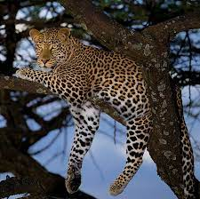
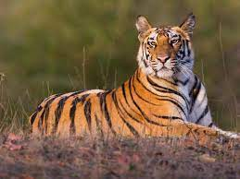
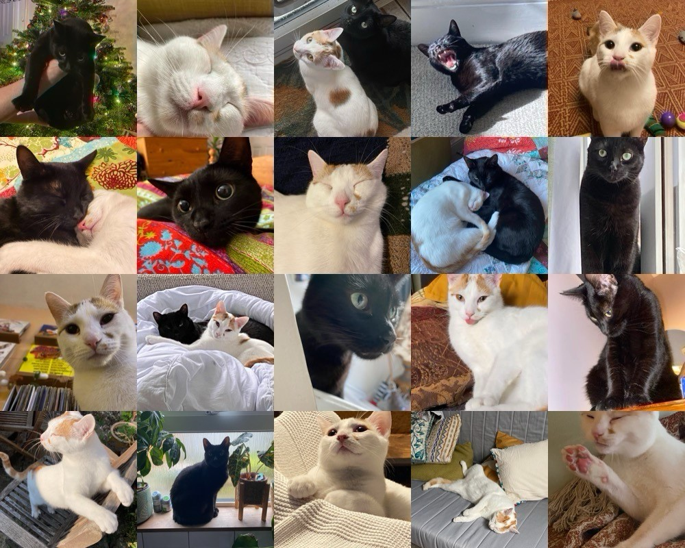
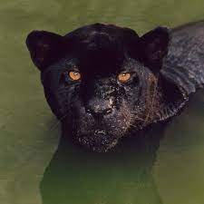
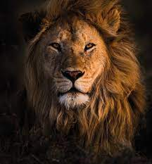
Instances as Attributes
BigCats()
DomesticCats()
Notes:
class BigCat:
def __init__(self, species, size):
self.species = species
self.size = size
def roar(self):
print(f"The {self.species} roars loudly!")
class DomesticCat:
def __init__(self, name, age):
self.name = name
self.age = age
self.big_cat_instance = BigCat(species="Tiger", size="large") # Instance of BigCat class
def meow(self):
print(f"{self.name} the domestic cat meows softly.")
def describe(self):
print(f"{self.name} is {self.age} years old.")
def big_cat_roar(self):
self.big_cat_instance.roar()
# Creating instances of DomesticCat
noche = DomesticCat(name="Noche", age=2)
weasley = DomesticCat(name="Weasley", age=1)
# Accessing methods of DomesticCat
noche.meow()
noche.describe()
weasley.meow()
weasley.describe()
# Accessing methods of BigCat via DomesticCat's instance
noche.big_cat_roar()
weasley.big_cat_roar()

Slide 35
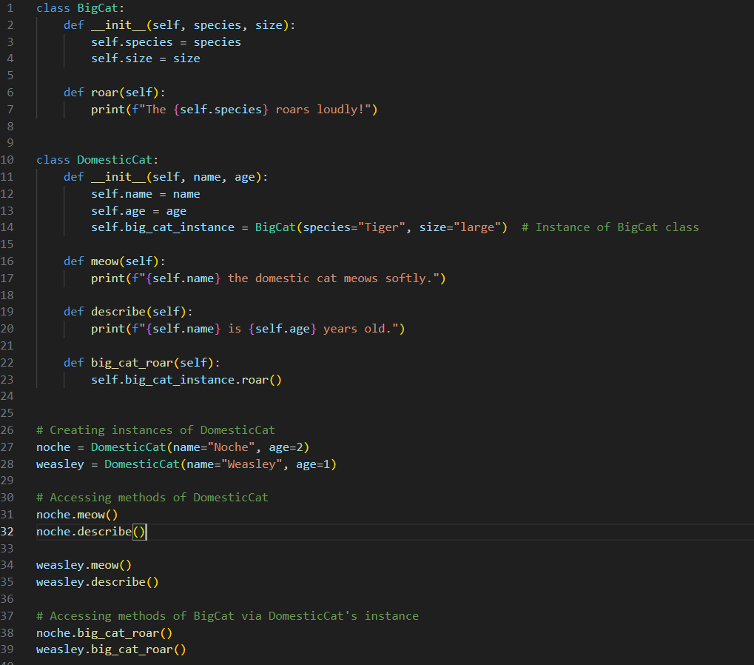
Notes:
class BigCat:
def __init__(self, species, size):
self.species = species
self.size = size
def roar(self):
print(f"The {self.species} roars loudly!")
class DomesticCat:
def __init__(self, name, age):
self.name = name
self.age = age
self.big_cat_instance = BigCat(species="Tiger", size="large") # Instance of BigCat class
def meow(self):
print(f"{self.name} the domestic cat meows softly.")
def describe(self):
print(f"{self.name} is {self.age} years old.")
def big_cat_roar(self):
self.big_cat_instance.roar()
# Creating instances of DomesticCat
noche = DomesticCat(name="Noche", age=2)
weasley = DomesticCat(name="Weasley", age=1)
# Accessing methods of DomesticCat
noche.meow()
noche.describe()
weasley.meow()
weasley.describe()
# Accessing methods of BigCat via DomesticCat's instance
noche.big_cat_roar()
weasley.big_cat_roar()

Slide 36
We can get more and more detailed, but this is just a way to describe different objects.

Slide 37
Importing Classes
As you add more functionality to your classes, your files can get long, even when you use inheritance properly. In keeping with the overall philosophy of Python, you’ll want to keep your files as uncluttered as possible. To help, Python lets you store classes in modules and then import the classes you need into your main program.
Notes:
From ___ import ____
Make sure to name your file with .py!
The same as using functions
Syntax for multiple imports
From ____ import ____, ____
Syntax for entire module
Import module_name
Import all classes from module syntax
From module_name import *
Same as functions, you can also add an alias!

Slide 38
The Python Standard Library
The Python standard library is a set of modules included with every Python installation. Now that you have a basic understanding of how classes work, you can start to use modules like these that other programmers have written. You can use any function or class in the standard library by including a simple import statement at the top of your file.
Notes:
https://docs.python.org/3/library/index.html
https://pymotw.com/3/

Slide 39
Onwards to exercise 9!

